Slide 1
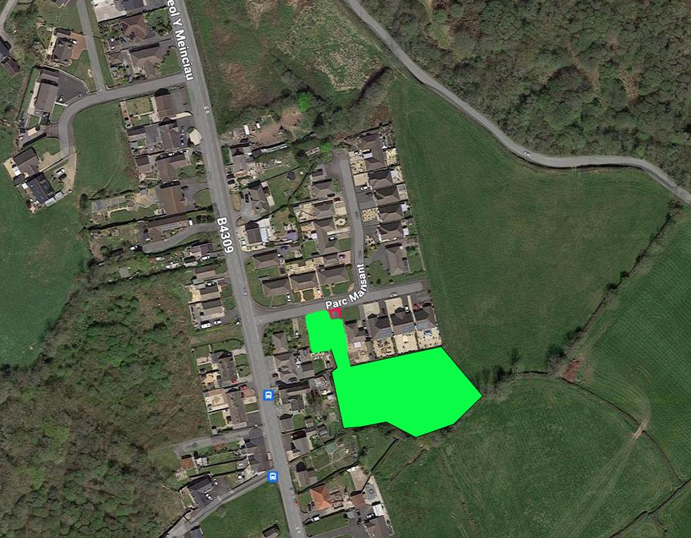
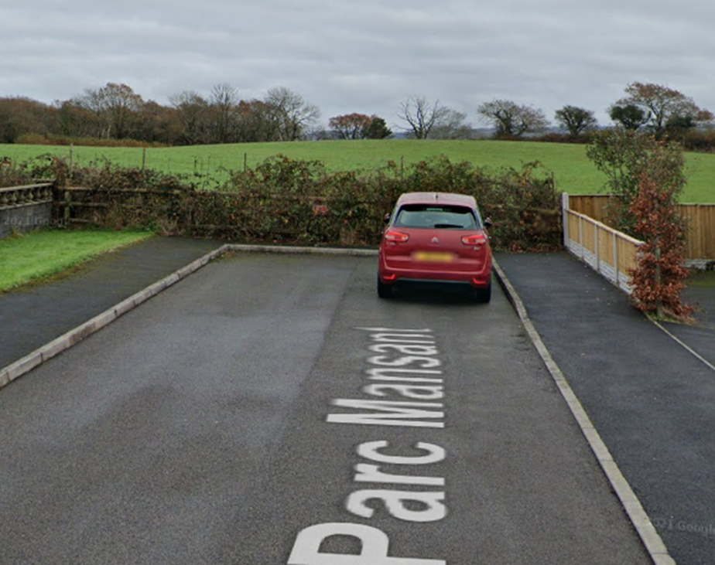
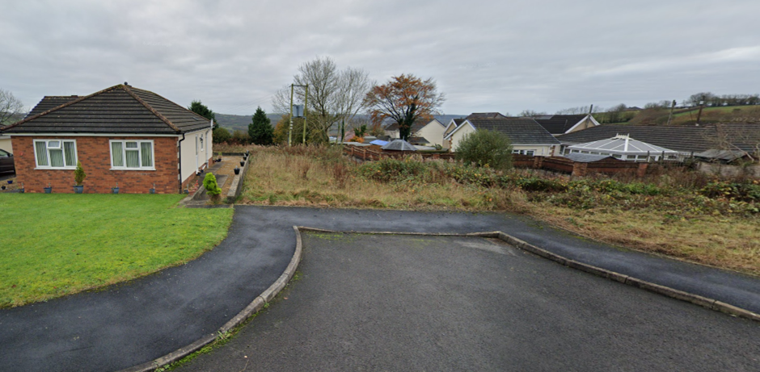
Parc Mansant, Pontiets. Current LDP Allocation Representation 4880
51° 46' 5.32", -4° 13' 36.00"
T3/5/h2
Access to the Field
All services from Parc Mansant end at this point, with rights of use and access
B4309 – Highway Access
Site Entrance

Slide 2
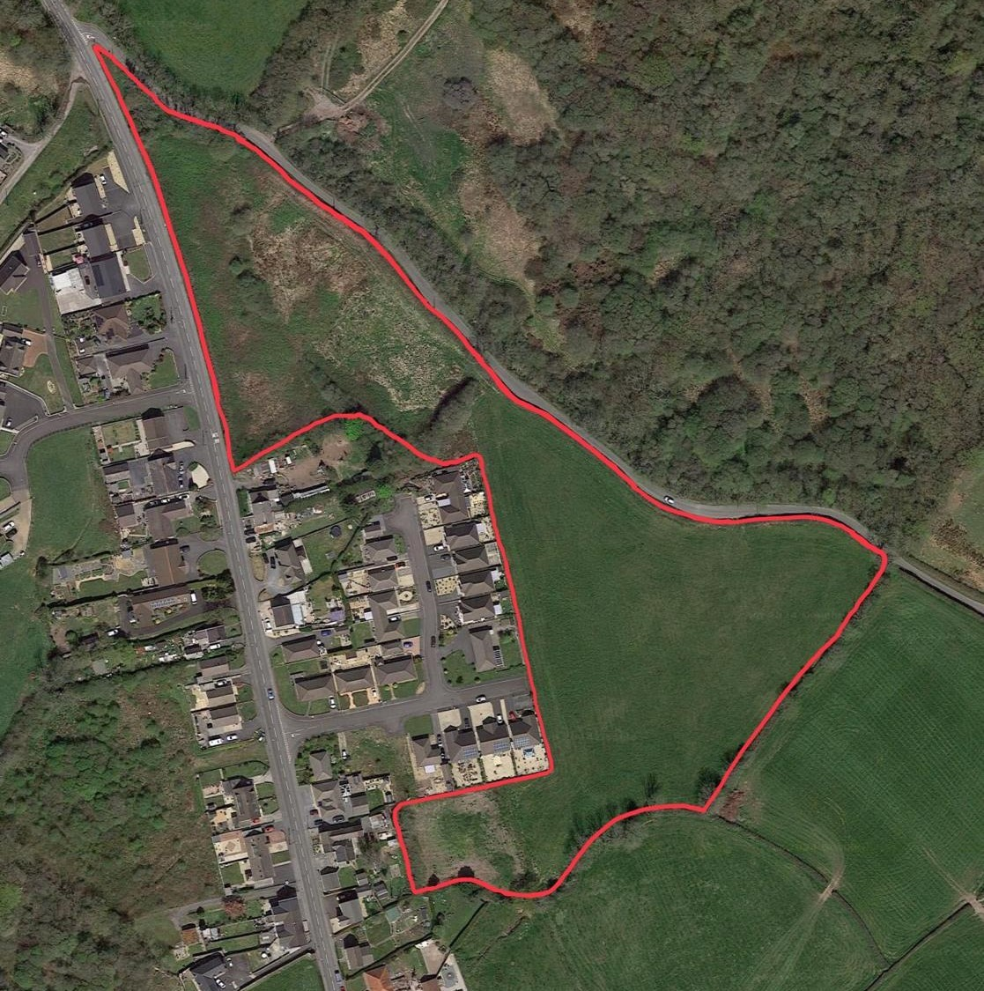
Parc Mansant, Pontiets. Representation 4873 to include the field in the new LDP
51° 46' 5.32", -4° 13' 36.00"
T3/5/h2
Access to the Field
All services from Parc Mansant end at this point, with rights of use and access
B4309 – Highway Access

Slide 3
Parc Mansant, Pontiets. Representation 4873 to include the field in the new LDP
Access to the Field
All services from Parc Mansant end at this point, with rights of access and use.
Access to the Field
Site Entrance
Access to the Field
T3/5/h2
51° 46' 5.32", -4° 13' 36.00"

